Slide 1
End-to-End Automation Flow with Human-in-Loop Approval

Slide 2
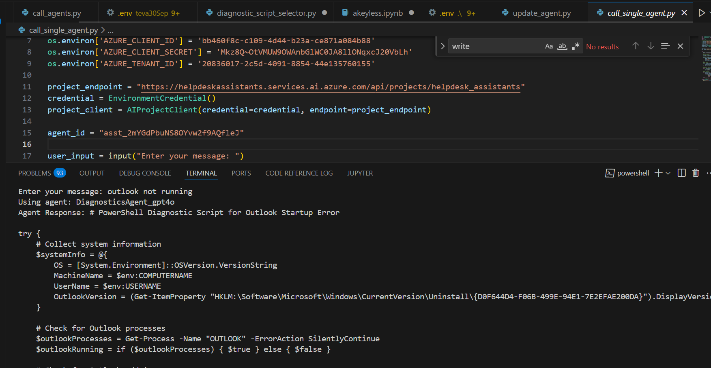
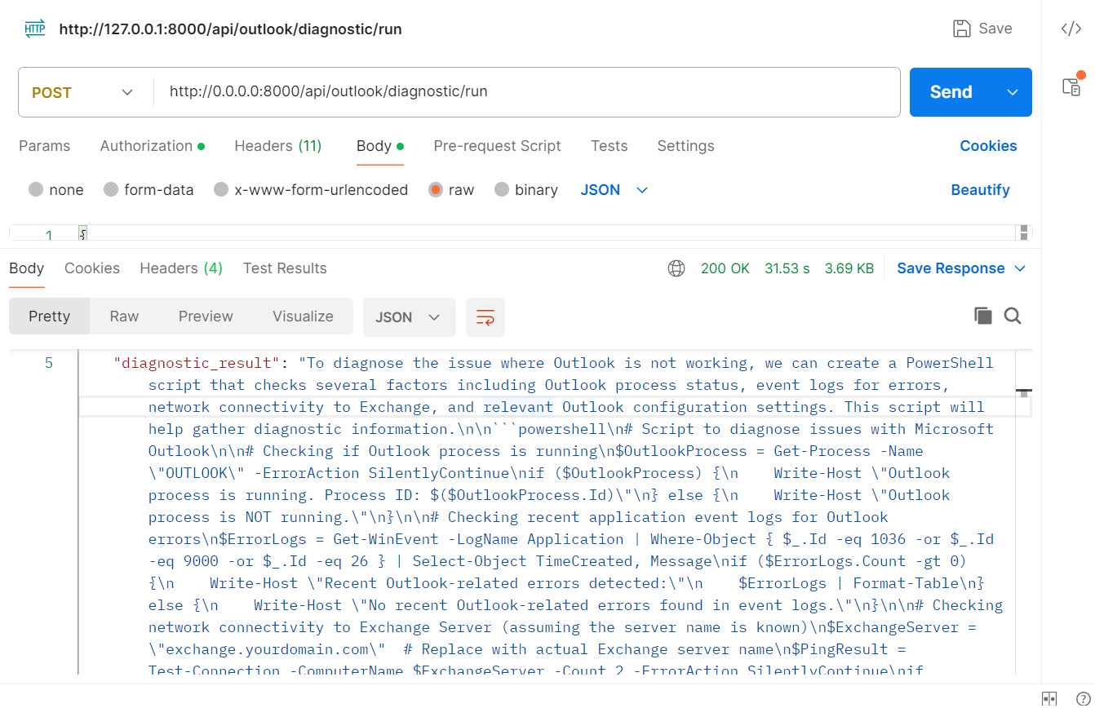
Step 1- Agents Generates PowerShell Scripts

Slide 3
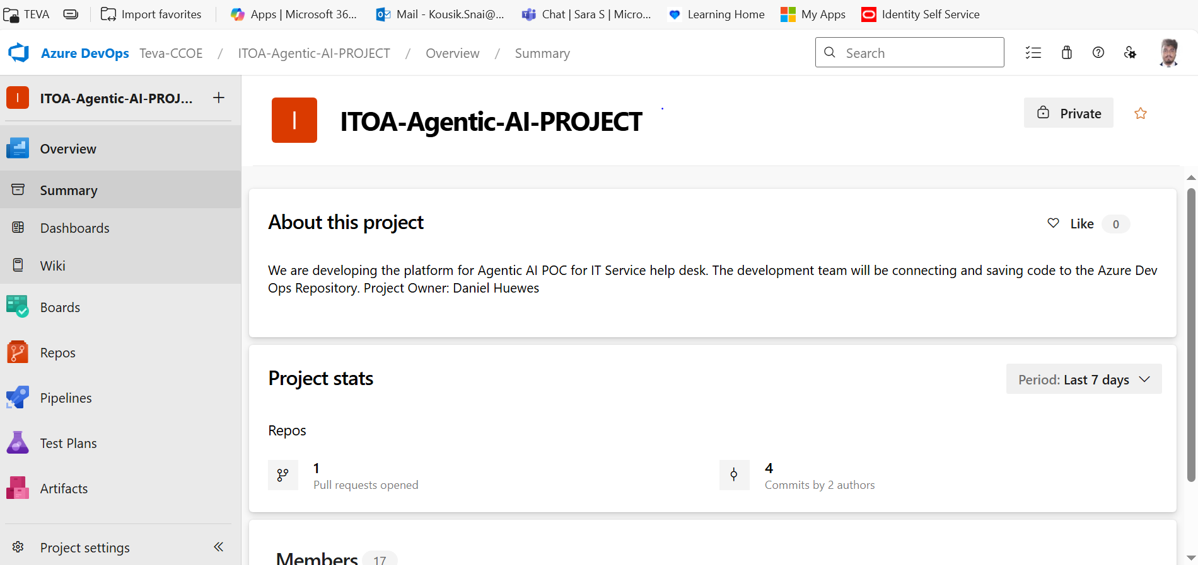
Step 2 – Developer Opens Azure DevOps Repository

Slide 4
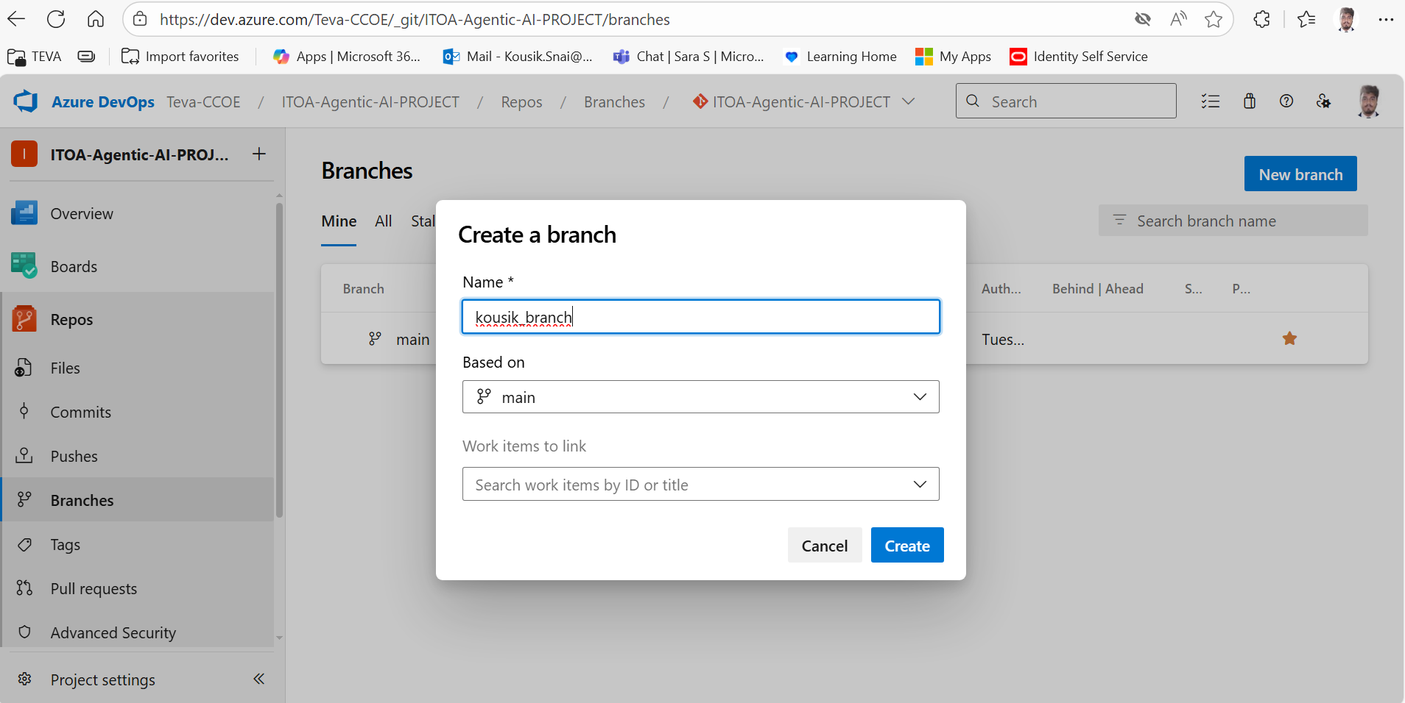
Step 3 – Create Branch From Source

Slide 5
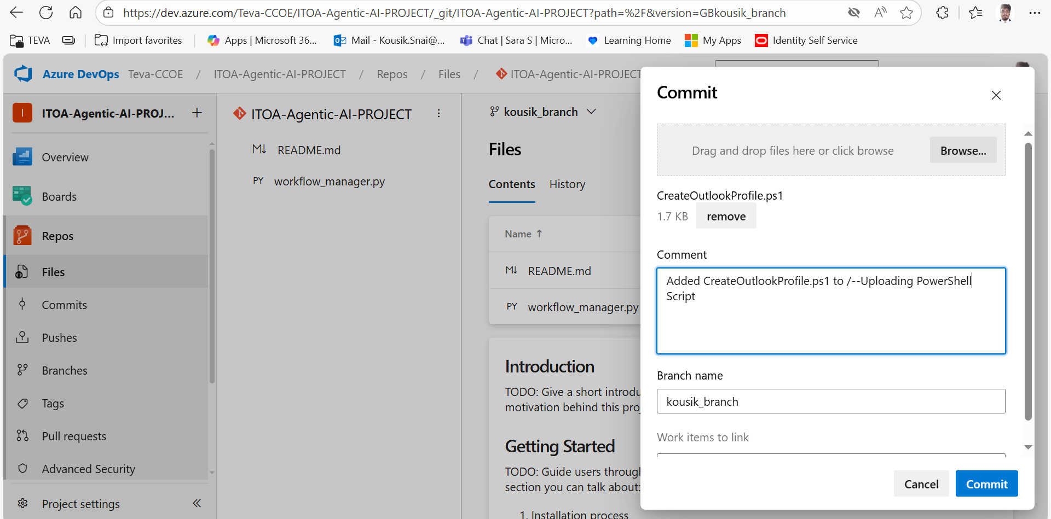
Step 4– Upload Script to Branch

Slide 6
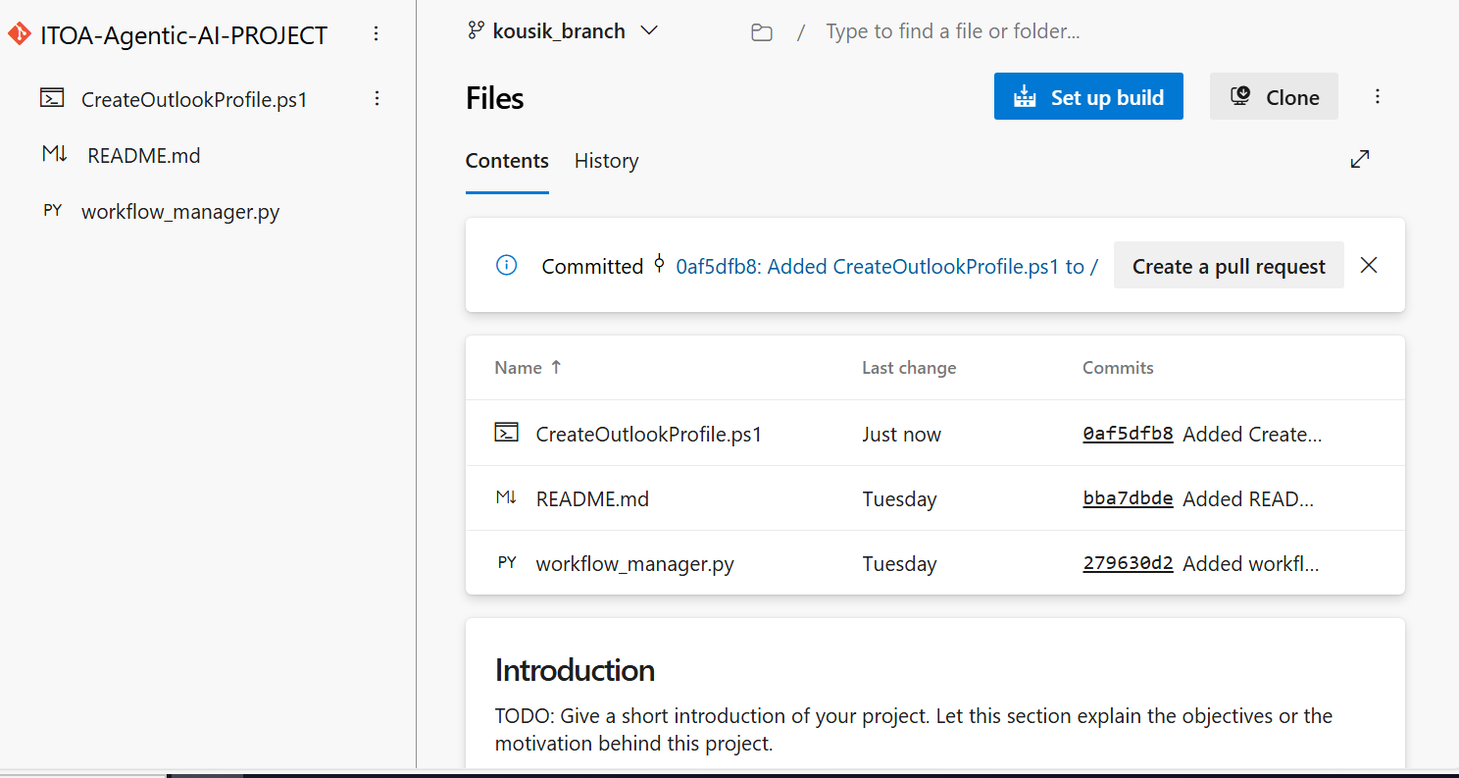
Step 5– Create Pull Request
Azure AI Search

Slide 7
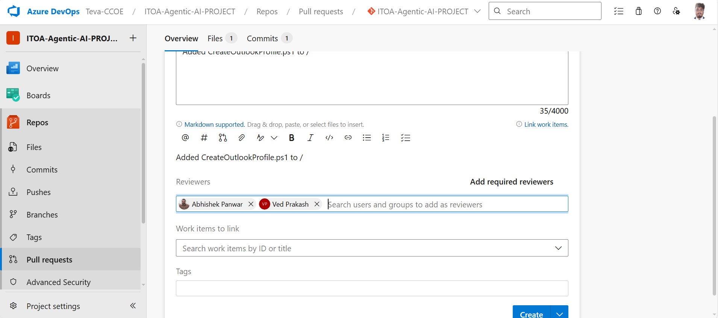
Step 6- Human Review

Slide 8
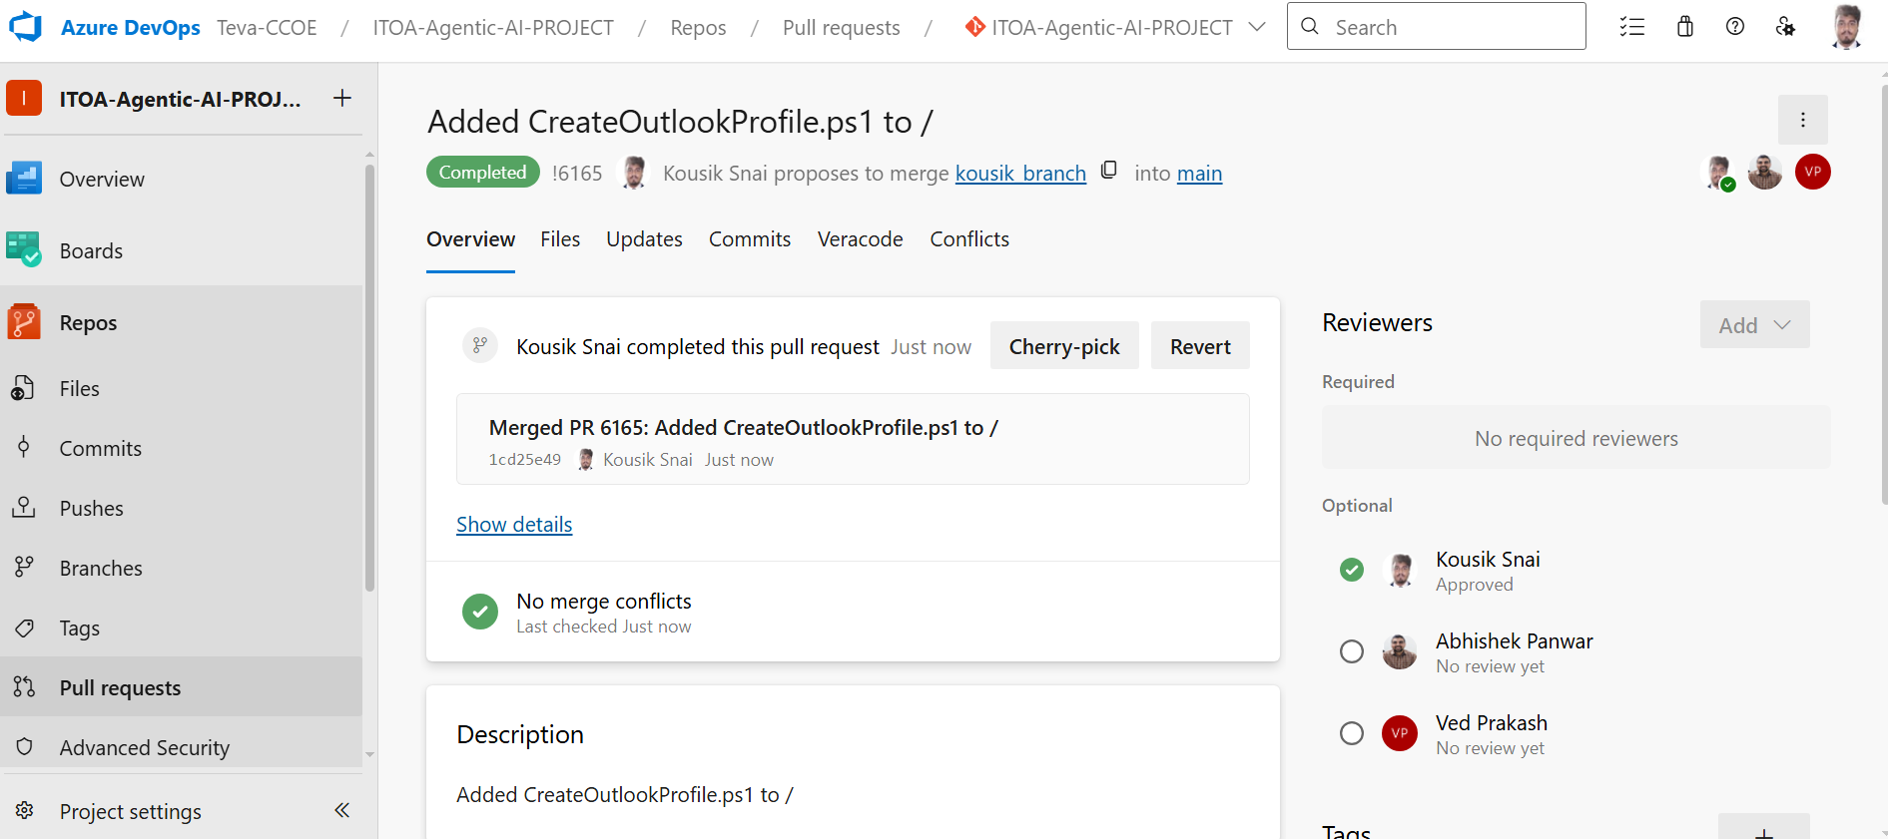
Step 7- Human Approval(If approved)

Slide 9
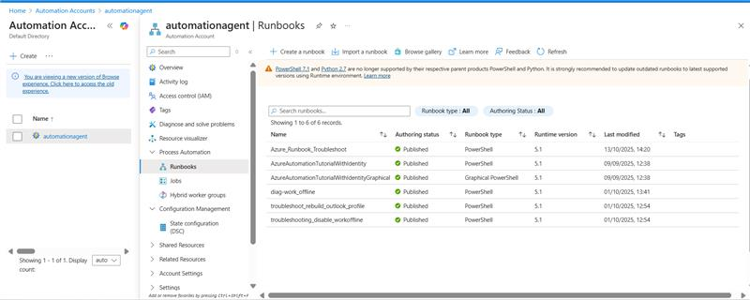
Step 9- Automation Publishing

Slide 10
Thank you

